Slide 1
7
Structured Query Language (Schema Definition, Basic Constraints, and Queries)

Slide 2
Outline
Overview of The SQL Query Language
SQL Data Definition
Basic Query Structure of SQL Queries
Additional Basic Operations
Set Operations
Null Values
Aggregate Functions
Nested Subqueries
Modification of the Database
Notes:
1

Slide 3
Outline
Join Expressions
Views
Transactions
Integrity Constraints
SQL Data Types and Schemas
Index Definition in SQL
Authorization
Notes:
1

Slide 4
History
IBM Sequel language developed as part of System R project at the IBM San Jose Research Laboratory
Renamed Structured Query Language (SQL)
ANSI and ISO standard SQL:
SQL-86
SQL-89
SQL-92
SQL:1999 (language name became Y2K compliant!)
SQL:2003
Commercial systems offer most, if not all, SQL-92 features, plus varying feature sets from later standards and special proprietary features.
Not all examples here may work on your particular system.

Slide 5
SQL Parts
DML -- provides the ability to query information from the database and to insert tuples into, delete tuples from, and modify tuples in the database.
integrity – the DDL includes commands for specifying integrity constraints.
View definition -- The DDL includes commands for defining views.
Transaction control –includes commands for specifying the beginning and ending of transactions.
Embedded SQL and dynamic SQL -- define how SQL statements can be embedded within general-purpose programming languages.
Authorization – includes commands for specifying access rights to relations and views.

Slide 6
Data Definition Language
The SQL data-definition language (DDL) allows the specification of information about relations, including:
The schema for each relation.
The type of values associated with each attribute.
The Integrity constraints
The set of indices to be maintained for each relation.
Security and authorization information for each relation.
The physical storage structure of each relation on disk.

Slide 7
Domain Types in SQL
char(n). Fixed length character string, with user-specified length n.
varchar(n). Variable length character strings, with user-specified maximum length n.
int. Integer (a finite subset of the integers that is machine-dependent).
smallint. Small integer (a machine-dependent subset of the integer domain type).
numeric(p,d). Fixed point number, with user-specified precision of p digits, with d digits to the right of decimal point. (ex., numeric(3,1), allows 44.5 to be stores exactly, but not 444.5 or 0.32)
real, double precision. Floating point and double-precision floating point numbers, with machine-dependent precision.
float(n). Floating point number, with user-specified precision of at least n digits.

Slide 8
Attribute Data Types and Domains in SQL
Basic data types
Numeric data types
Integer numbers: INTEGER, INT, and SMALLINT
Floating-point (real) numbers: FLOAT or REAL, and DOUBLE PRECISION
Character-string data types
Fixed length: CHAR(n), CHARACTER(n)
Varying length: VARCHAR(n), CHAR VARYING(n), CHARACTER VARYING(n)

Slide 9
Attribute Data Types and Domains in SQL (cont’d.)
Bit-string data types
Fixed length: BIT(n)
Varying length: BIT VARYING(n)
BLOB (Binary Large Object), BLOB(10G)
Boolean data type
Values of TRUE or FALSE or NULL
DATE data type
Components are YEAR, MONTH, and DAY in the form YYYY-MM-DD
Multiple mapping functions available in RDBMSs to change date formats

Slide 10
Attribute Data Types and Domains in SQL (cont’d.)
Additional data types
Timestamp data type
Includes the DATE and TIME fields
Plus a minimum of six positions for decimal fractions of seconds
Optional WITH TIME ZONE qualifier
DATE, TIME, Timestamp, INTERVAL data types can be cast or converted to string formats for comparison.

Slide 11
Create Table Construct
An SQL relation is defined using the create table command:
create table r
(A₁ D₁, A₂ D₂, ..., A_{n} D_{n}, (integrity-constraint₁), ..., (integrity-constraint_{k}))
r is the name of the relation
each A_{i} is an attribute name in the schema of relation r
D_{i} is the data type of values in the domain of attribute A_{i}
Example:
create table instructor ( ID char(5), name varchar(20), dept_name varchar(20), salary numeric(8,2))

Slide 12
Integrity Constraints in Create Table
Types of integrity constraints
primary key (A₁, ..., A_{n} )
foreign key (A_{m}, ..., A_{n} ) references r
not null
SQL prevents any update to the database that violates an integrity constraint.
Example:
create table instructor ( ID char(5), name varchar(20) not null, dept_name varchar(20), salary numeric(8,2), primary key (ID), foreign key (dept_name) references department);

Slide 13
And a Few More Relation Definitions
create table student ( ID varchar(5), name varchar(20) not null, dept_name varchar(20), tot_cred numeric(3,0), primary key (ID),
foreign key (dept_name) references department);
create table takes ( ID varchar(5), course_id varchar(8), sec_id varchar(8), semester varchar(6), year numeric(4,0), grade varchar(2),
primary key (ID, course_id, sec_id, semester, year) ,
foreign key (ID) references student,
foreign key (course_id, sec_id, semester, year) references section);

Slide 14
One more…
course (course_id, title, dept_name, credits)
create table course (
course_id varchar(8),
title varchar(50),
dept_name varchar(20),
credits numeric(2,0),
primary key (course_id),
foreign key (dept_name) references department);

Slide 15
Data Manipulation Language (DML)
Used to specify database retrievals and updates
DML commands (data sublanguage) can be embedded in a general-purpose programming language (host language), such as COBOL, C, C++, or Java.
A library of functions can also be provided to access the DBMS from a programming language
Alternatively, stand-alone DML commands can be applied directly (called a query language).

Slide 16
Updates to tables
Insert
insert into instructor values ('10211', 'Smith', 'Biology', 66000);
Delete
Remove all tuples from the student relation
delete from student
Drop Table
drop table r
Alter
alter table r add A D
where A is the name of the attribute to be added to relation r and D is the domain of A.
All exiting tuples in the relation are assigned null as the value for the new attribute.
alter table r drop A
where A is the name of an attribute of relation r
Dropping of attributes not supported by many databases.

Slide 17
Basic Query Structure
A typical SQL query has the form: select A₁, A₂, ..., A_{n} from r₁, r₂, ..., r_{m} where P
A_{i} represents an attribute
R_{i} represents a relation
P is a predicate.
The result of an SQL query is a relation.
Notes:
2

Slide 18
The select Clause
The select clause lists the attributes desired in the result of a query
corresponds to the projection operation of the relational algebra
Example: find the names of all instructors: select name from instructor
NOTE: SQL names are case insensitive (i.e., you may use upper- or lower-case letters.)
E.g., Name ≡ NAME ≡ name
Some people use upper case wherever we use bold font.
Notes:
3

Slide 19
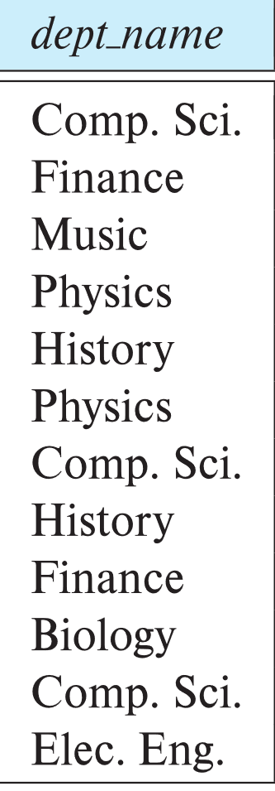
The select Clause (Cont.)
SQL allows duplicates in relations as well as in query results.
To force the elimination of duplicates, insert the keyword distinct after select.
Find the department names of all instructors, and remove duplicates
select distinct dept_name from instructor
The keyword all specifies that duplicates should not be removed.
select all dept_name from instructor
Notes:
4

Slide 20
The select Clause (Cont.)
An asterisk in the select clause denotes “all attributes”
select * from instructor
An attribute can be a literal with no from clause
select '437'
Results is a table with one column and a single row with value “437”
Can give the column a name using:
select '437' as FOO
An attribute can be a literal with from clause
select 'A' from instructor
Result is a table with one column and N rows (number of tuples in the instructors table), each row with value “A”
Notes:
5

Slide 21
The select Clause (Cont.)
The select clause can contain arithmetic expressions involving the operation, +, –, ∗, and /, and operating on constants or attributes of tuples.
The query:
select ID, name, salary/12 from instructor
would return a relation that is the same as the instructor relation, except that the value of the attribute salary is divided by 12.
Can rename “salary/12” using the as clause:
select ID, name, salary/12 as monthly_salary
Notes:
5

Slide 22
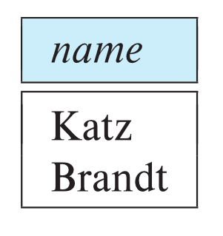
The where Clause
The where clause specifies conditions that the result must satisfy
Corresponds to the selection predicate of the relational algebra.
To find all instructors in Comp. Sci. dept
select name from instructor where dept_name = 'Comp. Sci.'
SQL allows the use of the logical connectives and, or, and not
The operands of the logical connectives can be expressions involving the comparison operators <, <=, >, >=, =, and <>.
Comparisons can be applied to results of arithmetic expressions
To find all instructors in Comp. Sci. dept with salary > 70000
select name from instructor where dept_name = 'Comp. Sci.' and salary > 70000
Notes:
6

Slide 23
The from Clause
The from clause lists the relations involved in the query
Find the Cartesian product instructor X teaches
select * from instructor, teaches
generates every possible instructor – teaches pair, with all attributes from both relations.
For common attributes (e.g., ID), the attributes in the resulting table are renamed using the relation name (e.g., instructor.ID)
Cartesian product not very useful directly, but useful combined with where-clause condition (selection operation in relational algebra).
Notes:
8

Slide 24
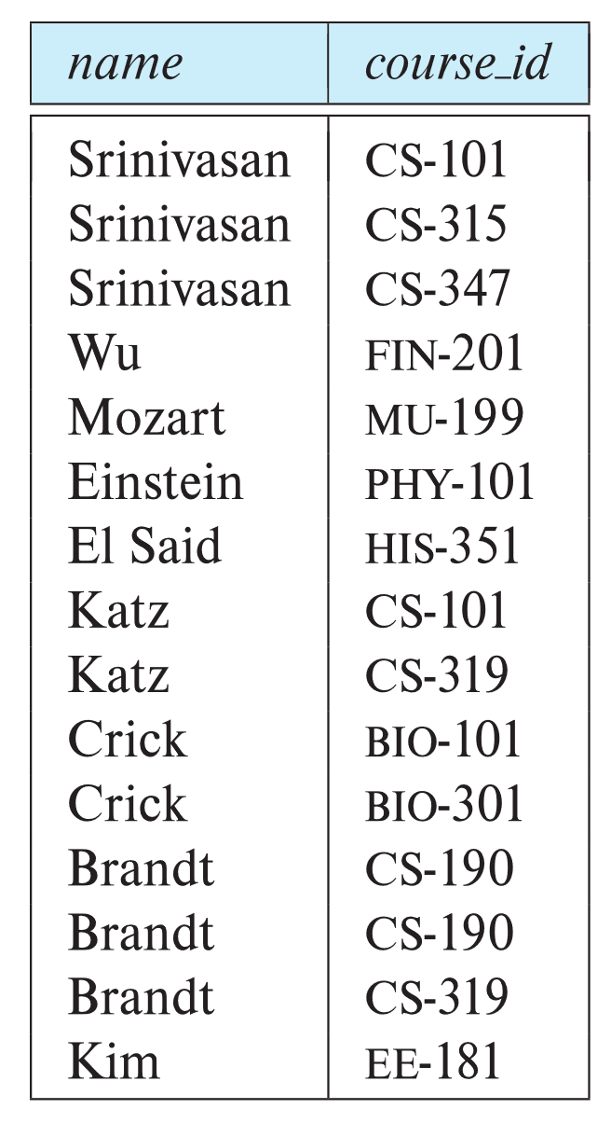
Examples
Find the names of all instructors who have taught some course and the course_id
select name, course_id from instructor , teaches where instructor.ID = teaches.ID
Find the names of all instructors in the Art department who have taught some course and the course_id
select name, course_id from instructor , teaches where instructor.ID = teaches.ID and instructor.dept_name = 'Art'
Notes:
9

Slide 25
The Rename Operation
The SQL allows renaming relations and attributes using the as clause:
old-name as new-name
Find the names of all instructors who have a higher salary than some instructor in 'Comp. Sci'.
select distinct T.name from instructor as T, instructor as S where T.salary > S.salary and S.dept_name = 'Comp. Sci.’
Keyword as is optional and may be omitted instructor as T ≡ instructor T
Notes:
9

Slide 26
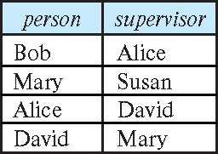
Self Join Example
Relation emp-super
Find the supervisor of “Bob”
Find the supervisor of the supervisor of “Bob”
Can you find ALL the supervisors (direct and indirect) of “Bob”?
Notes:
9

Slide 27
String Operations
SQL includes a string-matching operator for comparisons on character strings. The operator like uses patterns that are described using two special characters:
percent ( % ). The % character matches any substring.
underscore ( _ ). The _ character matches any character.
Find the names of all instructors whose name includes the substring “dar”.
select name from instructor where name like '%dar%'
Match the string “100%”
like '100 \%' escape '\'
in that above we use backslash (\) as the escape character.

Slide 28
String Operations (Cont.)
Patterns are case sensitive.
Pattern matching examples:
'Intro%' matches any string beginning with “Intro”.
'%Comp%' matches any string containing “Comp” as a substring.
'_ _ _' matches any string of exactly three characters.
'_ _ _ %' matches any string of at least three characters.
SQL supports a variety of string operations such as
concatenation (using “||”)
converting from upper to lower case (and vice versa)
finding string length, extracting substrings, etc.

Slide 29
Ordering the Display of Tuples
List in alphabetic order the names of all instructors
select distinct name from instructor order by name
We may specify desc for descending order or asc for ascending order, for each attribute; ascending order is the default.
Example: order by name desc
Can sort on multiple attributes
Example: order by dept_name, name

Slide 30
Where Clause Predicates
SQL includes a between comparison operator
Example: Find the names of all instructors with salary between $90,000 and $100,000 (that is, ≥ $90,000 and ≤ $100,000)
select name from instructor where salary between 90000 and 100000
Tuple comparison
select name, course_id from instructor, teaches where (instructor.ID, dept_name) = (teaches.ID, 'Biology');
Notes:
7

Slide 31
Set Operations
Find courses that ran in Fall 2017 or in Spring 2018
(select course_id from section where sem = 'Fall' and year = 2017) union (select course_id from section where sem = 'Spring' and year = 2018)
Find courses that ran in Fall 2017 and in Spring 2018
(select course_id from section where sem = 'Fall' and year = 2017) intersect (select course_id from section where sem = 'Spring' and year = 2018)
Find courses that ran in Fall 2017 but not in Spring 2018
(select course_id from section where sem = 'Fall' and year = 2017) except (select course_id from section where sem = 'Spring' and year = 2018)

Slide 32
Set Operations (Cont.)
Set operations union, intersect, and except
Each of the above operations automatically eliminates duplicates
To retain all duplicates use the
union all,
intersect all
except all.

Slide 33
Null Values
It is possible for tuples to have a null value, denoted by null, for some of their attributes
null signifies an unknown value or that a value does not exist.
The result of any arithmetic expression involving null is null
Example: 5 + null returns null
The predicate is null can be used to check for null values.
Example: Find all instructors whose salary is null.
select name
from instructor
where salary is null
The predicate is not null succeeds if the value on which it is applied is not null.

Slide 34
Null Values (Cont.)
SQL treats as unknown the result of any comparison involving a null value (other than predicates is null and is not null).
Example: 5 < null or null <> null or null = null
The predicate in a where clause can involve Boolean operations (and, or, not); thus the definitions of the Boolean operations need to be extended to deal with the value unknown.
and : (true and unknown) = unknown, (false and unknown) = false, (unknown and unknown) = unknown
or: (unknown or true) = true, (unknown or false) = unknown (unknown or unknown) = unknown
Result of where clause predicate is treated as false if it evaluates to unknown

Slide 35
Aggregate Functions
These functions operate on the multiset of values of a column of a relation, and return a value
avg: average value min: minimum value max: maximum value sum: sum of values count: number of values

Slide 36
Aggregate Functions Examples
Find the average salary of instructors in the Computer Science department
select avg (salary) from instructor where dept_name= 'Comp. Sci.';
Find the total number of instructors who teach a course in the Spring 2018 semester
select count (distinct ID) from teaches where semester = 'Spring' and year = 2018;
Find the number of tuples in the course relation
select count (*) from course;

Slide 37
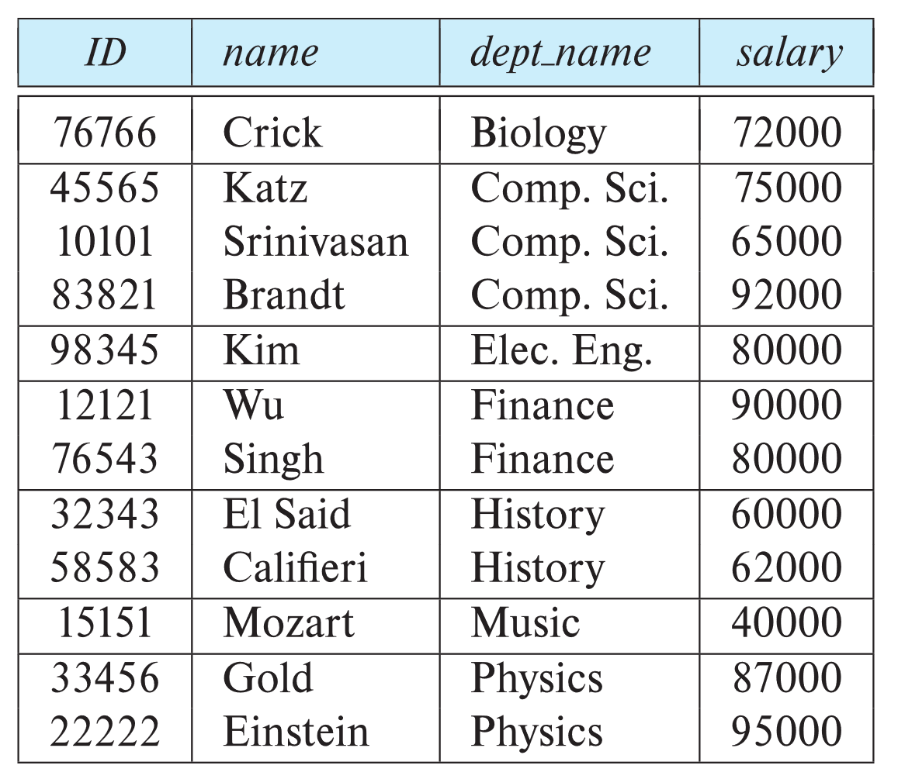
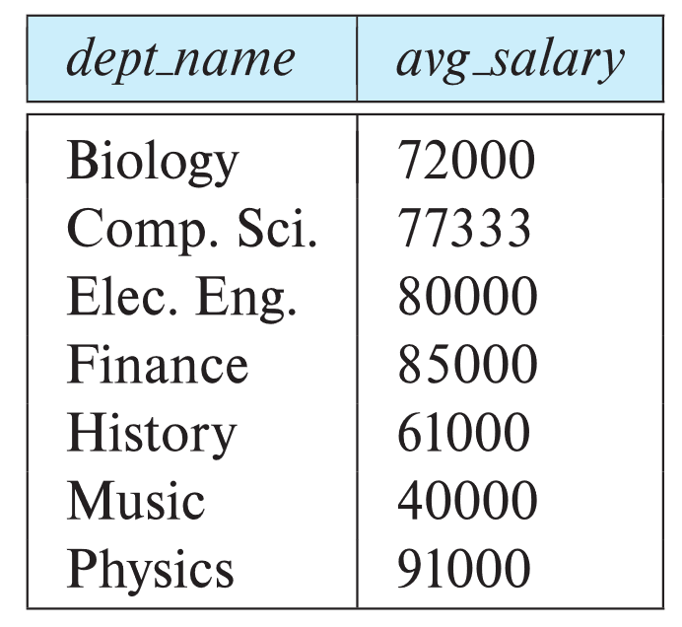
Aggregate Functions – Group By
Find the average salary of instructors in each department
select dept_name, avg (salary) as avg_salary from instructor group by dept_name;

Slide 38

Aggregation (Cont.)
Attributes in select clause outside of aggregate functions must appear in group by list
/* erroneous query */ select dept_name, ID , avg (salary) from instructor group by dept_name;

Slide 39
Aggregate Functions – Having Clause
Find the names and average salaries of all departments whose average salary is greater than 42000
select dept_name, avg (salary) as avg_salary
from instructor
group by dept_name
having avg (salary) > 42000;
Note: predicates in the having clause are applied after the formation of groups whereas predicates in the where clause are applied before forming groups

Slide 40
Nested Subqueries
SQL provides a mechanism for the nesting of subqueries. A subquery is a select-from-where expression that is nested within another query.
The nesting can be done in the following SQL query select A₁, A₂, ..., A_{n} from r₁, r₂, ..., r_{m} where P as follows:
From clause: r_{i} can be replaced by any valid subquery
Where clause: P can be replaced with an expression of the form:
B <operation> (subquery)
B is an attribute and <operation> to be defined later.
Select clause:
A_{i} can be replaced be a subquery that generates a single value.

Slide 41
Set Membership

Slide 42
Set Membership
Find courses offered in Fall 2017 and in Spring 2018
select distinct course_id
from section
where semester = 'Fall' and year= 2017 and course_id in (select course_id
from section
where semester = 'Spring' and year= 2018);
Find courses offered in Fall 2017 but not in Spring 2018
select distinct course_id
from section
where semester = 'Fall' and year= 2017 and course_id not in (select course_id
from section
where semester = 'Spring' and year= 2018);

Slide 43
Set Membership (Cont.)
Name all instructors whose name is neither “Mozart” nor Einstein”
select distinct name
from instructor
where name not in ('Mozart', 'Einstein')
Find the total number of (distinct) students who have taken course sections taught by the instructor with ID 10101
select count (distinct ID)
from takes
where (course_id, sec_id, semester, year) in (select course_id, sec_id, semester, year
from teaches
where teaches.ID= 10101);
Note: Above query can be written in a much simpler manner. The formulation above is simply to illustrate SQL features

Slide 44
Explicit Sets
Retrieve the Social Security numbers of all employees who work on project numbers 1, 2, or 3.
SELECT DISTINCT Essn
FROM WORKS_ON
WHERE Pno IN (1, 2, 3)

Slide 45
Set Comparison

Slide 46
Definition of “some” Clause
F <comp> some r ⇔ ∃ t ∈ r such that (F <comp> t ) Where <comp> can be: <, ≤, >, =, ≠
0
(5 < some
5
) = true
6
(read: 5 < some tuple in the relation)
0
(5 < some
5
) = false
0
(5 = some
) = true
5
0
(5 ≠ some
5
) = true (since 0 ≠ 5)
(= some) ≡ in
However, (≠ some) ≡ not in

Slide 47
Set Comparison – “some” Clause
Find names of instructors with salary greater than that of some (at least one) instructor in the Biology department.
Same query using > some clause
select distinct T.name
from instructor as T, instructor as S
where T.salary > S.salary and S.dept name = 'Biology';
select name
from instructor
where salary > some (select salary
from instructor
where dept name = 'Biology');

Slide 48
Definition of “all” Clause
F <comp> all r ⇔ ∀ t ∈ r (F <comp> t)
0
(5 < all
5
) = false
6
6
(5 < all
) = true
10
4
(5 = all
) = false
5
4
(5 ≠ all
) = true (since 5 ≠ 4 and 5 ≠ 6)
6
(≠ all) ≡ not in
However, (= all) ≡ in

Slide 49
Set Comparison – “all” Clause
Find the names of all instructors whose salary is greater than the salary of all instructors in the Biology department.
select name
from instructor
where salary > all (select salary
from instructor
where dept name = 'Biology');

Slide 50
Test for Empty Relations
The exists construct returns the value true if the argument subquery is nonempty.
exists r ⇔ r ≠ Ø
not exists r ⇔ r = Ø

Slide 51
Use of “exists” Clause
Yet another way of specifying the query “Find all courses taught in both the Fall 2017 semester and in the Spring 2018 semester”
select course_id from section as S where semester = 'Fall' and year = 2017 and exists (select * from section as T where semester = 'Spring' and year= 2018 and S.course_id = T.course_id);
Correlation name – variable S in the outer query
Correlated subquery – the inner query

Slide 52
Use of “not exists” Clause
Find all students who have taken all courses offered in the Biology department.
Note that X – Y = Ø ⇔ X ⊆ Y
Note: Cannot write this query using = all and its variants
select distinct S.ID, S.name
from student as S
where not exists ( (select course_id
from course
where dept_name = 'Biology')
except
(select T.course_id
from takes as T
where S.ID = T.ID));
First nested query lists all courses offered in Biology
Second nested query lists all courses a particular student took

Slide 53
Test for Absence of Duplicate Tuples
Find all courses that were offered at most once in 2017
select T.course_id
from course as T
where 1 >= (
select count(R.course_id)
from section as R
where T.course id= R.course_id
and R.year = 2017
);

Slide 54
Subqueries in the From Clause

Slide 55
Subqueries in the Form Clause
SQL allows a subquery expression to be used in the from clause
Find the average instructors’ salaries of those departments where the average salary is greater than $42,000.”
select dept_name, avg_salary
from ( select dept_name, avg (salary) as avg_salary from instructor
group by dept_name)
where avg_salary > 42000;
Note that we do not need to use the having clause
Another way to write above query
select dept_name, avg_salary from ( select dept_name, avg (salary) from instructor group by dept_name)
as dept_avg (dept_name, avg_salary)
where avg_salary > 42000;

Slide 56
With Clause
The with clause provides a way of defining a temporary relation whose definition is available only to the query in which the with clause occurs.
Find all departments with the maximum budget with max_budget (value) as (select max(budget) from department) select department.dept_name from department, max_budget where department.budget = max_budget.value;

Slide 57
Complex Queries using With Clause
Find all departments where the total salary is greater than the average of the total salary at all departments
with dept_total (dept_name, value) as
(select dept_name, sum(salary)
from instructor
group by dept_name),
dept_total_avg(value) as
(select avg(value)
from dept_total)
select dept_name
from dept_total, dept_total_avg
where dept_total.value > dept_total_avg.value;

Slide 58
Scalar Subquery
Scalar subquery is one which is used where a single value is expected
List all departments along with the number of instructors in each department
select dept_name, ( select count(*) from instructor where department.dept_name = instructor.dept_name) as num_instructors from department;
Runtime error if subquery returns more than one result tuple

Slide 59
Modification of the Database
Insertion of new tuples into a given relation
Updating of values in some tuples in a given relation
Deletion of tuples from a given relation.

Slide 60
Insertion
Add a new tuple to course
insert into course values ('CS-437', 'Database Systems', 'Comp. Sci.', 4);
or equivalently insert into course (course_id, title, dept_name, credits) values ('CS-437', 'Database Systems', 'Comp. Sci.', 4);
Add a new tuple to student with tot_creds set to null
insert into student values ('3003', 'Green', 'Finance', null);

Slide 61
Insertion (Cont.)
Make each student in the Music department who has earned more than 144 credit hours an instructor in the Music department with a salary of $18,000.
insert into instructor select ID, name, dept_name, 18000 from student where dept_name = 'Music' and total_cred > 144;
The select from where statement is evaluated fully before any of its results are inserted into the relation.
Otherwise queries like
insert into table2 select * from table1
would cause problem

Slide 62
Updates
Give a 5% salary raise to all instructors
update instructor set salary = salary * 1.05
Give a 5% salary raise to those instructors who earn less than 70000 update instructor set salary = salary * 1.05 where salary < 70000;
Give a 5% salary raise to instructors whose salary is less than average
update instructor set salary = salary * 1.05 where salary < (select avg (salary) from instructor);

Slide 63
Updates (Cont.)
Increase salaries of instructors whose salary is over $100,000 by 3%, and all others by a 5%
Write two update statements:
update instructor set salary = salary * 1.03 where salary > 100000; update instructor set salary = salary * 1.05 where salary <= 100000;
The order is important
Can be done better using the case statement (next slide)

Slide 64
Case Statement for Conditional Updates
Same query as before but with case statement
update instructor set salary = case when salary <= 100000 then salary * 1.05 else salary * 1.03 end

Slide 65
Updates with Scalar Subqueries
Recompute and update tot_creds value for all students
update student S set tot_cred = (select sum(credits) from takes, course where takes.course_id = course.course_id and S.ID= takes.ID. and takes.grade <> 'F' and takes.grade is not null);
Sets tot_creds to null for students who have not taken any course
Instead of sum(credits), use:
case when sum(credits) is not null then sum(credits) else 0 end

Slide 66
Deletion
Delete all instructors
delete from instructor
Delete all instructors from the Finance department delete from instructor where dept_name= 'Finance’;
Delete all tuples in the instructor relation for those instructors associated with a department located in the Watson building.
delete from instructor where dept name in (select dept name from department where building = 'Watson');

Slide 67
Deletion (Cont.)
Delete all instructors whose salary is less than the average salary of instructors
Problem: as we delete tuples from instructor, the average salary changes
Solution used in SQL:
First, compute avg (salary) and find all tuples to delete
Next, delete all tuples found above (without recomputing avg or retesting the tuples)
delete from instructor
where salary < (select avg (salary)
from instructor);

Slide 68
Joined Relations
Join operations take two relations and return as a result another relation.
A join operation is a Cartesian product which requires that tuples in the two relations match (under some condition). It also specifies the attributes that are present in the result of the join
The join operations are typically used as subquery expressions in the from clause
Three types of joins:
Natural join
Inner join
Outer join

Slide 69
Natural Join in SQL
Natural join matches tuples with the same values for all common attributes, and retains only one copy of each common column.
List the names of instructors along with the course ID of the courses that they taught
select name, course_id from students, takes where student.ID = takes.ID;
Same query in SQL with “natural join” construct
select name, course_id from student natural join takes;

Slide 70
Natural Join in SQL (Cont.)
The from clause can have multiple relations combined using natural join:
select A₁, A₂, … A_{n} from r₁ natural join r₂ natural join .. natural join r_{n} where P ;

Slide 71
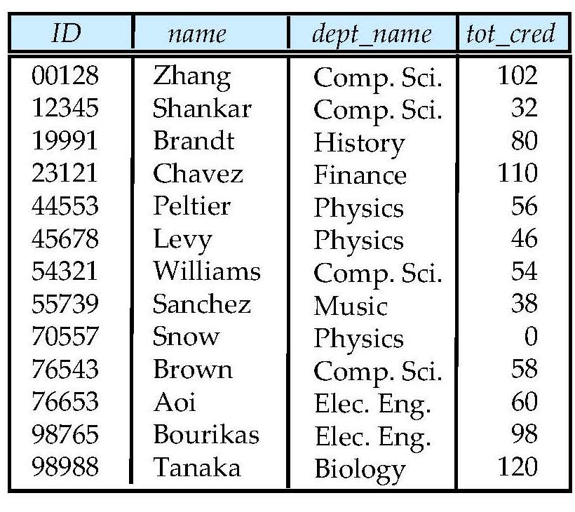
Student Relation

Slide 72
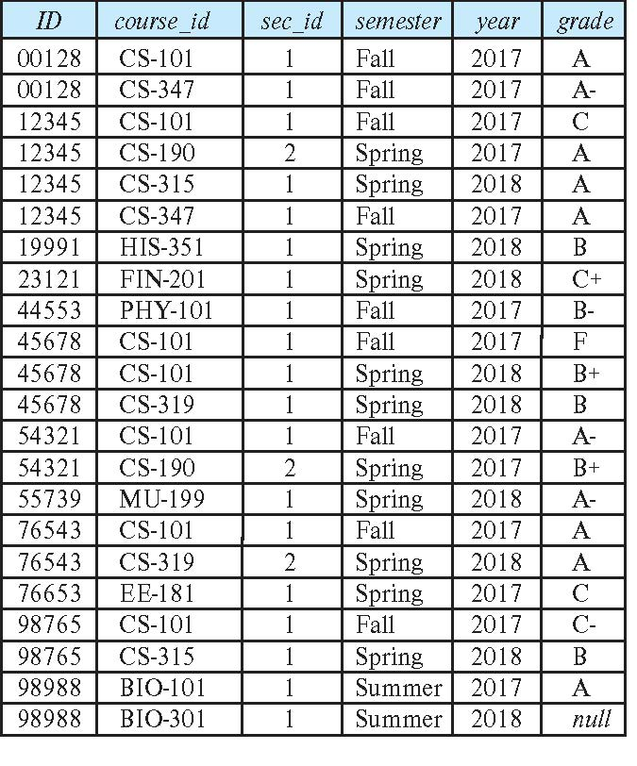
Takes Relation

Slide 73
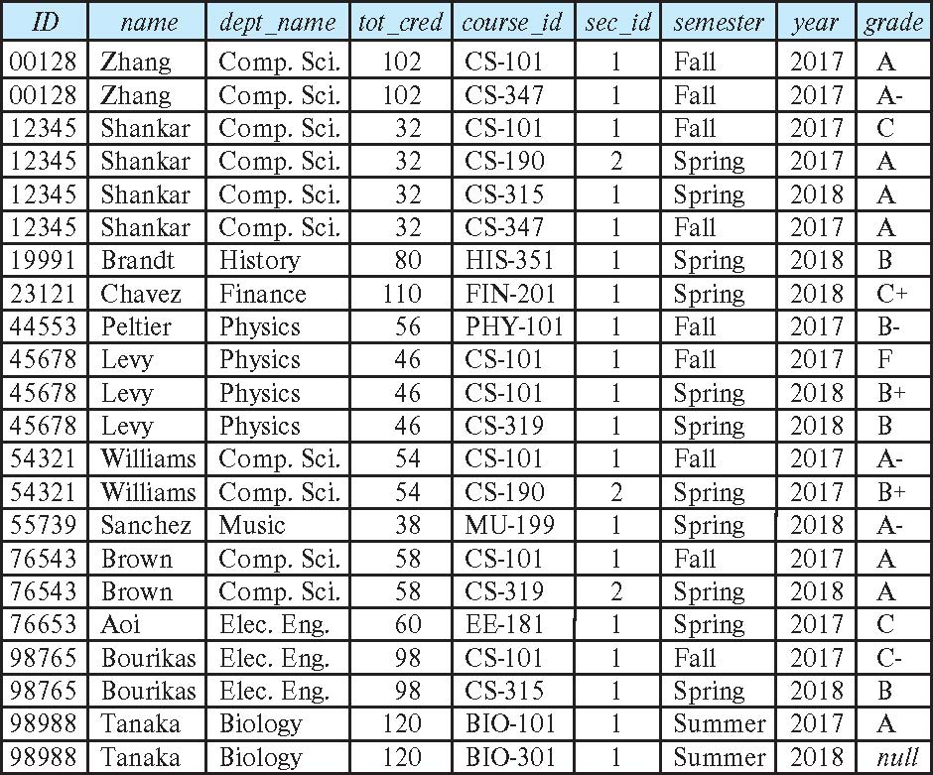
student natural join takes

Slide 74
Dangerous in Natural Join
Beware of unrelated attributes with same name which get equated incorrectly
Example -- List the names of students instructors along with the titles of courses that they have taken
Correct version
select name, title from student natural join takes, course where takes.course_id = course.course_id;
Incorrect version
select name, title from student natural join takes natural join course;
This query omits all (student name, course title) pairs where the student takes a course in a department other than the student's own department.
The correct version (above), correctly outputs such pairs.

Slide 75
Natural Join with Using Clause
To avoid the danger of equating attributes erroneously, we can use the “using” construct that allows us to specify exactly which columns should be equated.
Query example
select name, title
from (student natural join takes) join course
using (course_id)

Slide 76
Join Condition
The on condition allows a general predicate over the relations being joined
This predicate is written like a where clause predicate except for the use of the keyword on
Query example
select * from student join takes on student.ID = takes.ID
The on condition above specifies that a tuple from student matches a tuple from takes if their ID values are equal.
Equivalent to:
select * from student , takes where student.ID = takes.ID

Slide 77
Join Condition (Cont.)
The on condition allows a general predicate over the relations being joined.
This predicate is written like a where clause predicate except for the use of the keyword on.
Query example
select * from student join takes on student.ID = takes.ID
The on condition above specifies that a tuple from student matches a tuple from takes if their ID values are equal.
Equivalent to:
select * from student , takes where student.ID = takes.ID

Slide 78
Outer Join
An extension of the join operation that avoids loss of information.
Computes the join and then adds tuples form one relation that does not match tuples in the other relation to the result of the join.
Uses null values.
Three forms of outer join:
left outer join
right outer join
full outer join

Slide 79
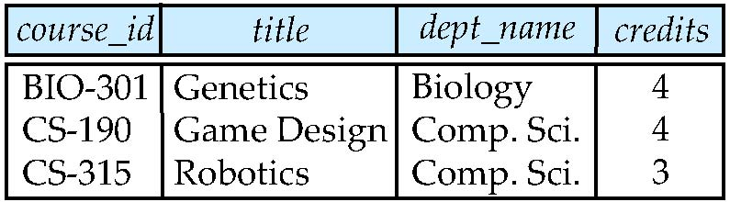
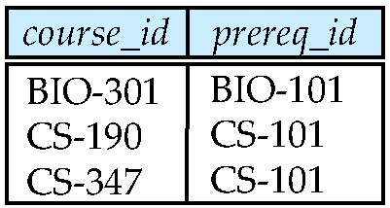
Outer Join Examples
Relation course
Relation prereq
Observe that
course information is missing CS-437
prereq information is missing CS-315
x

Slide 80
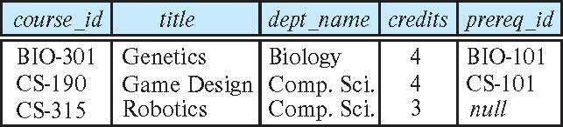
Left Outer Join
course natural left outer join prereq
In relational algebra: course ⟕ prereq

Slide 81
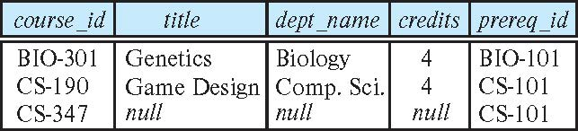
Right Outer Join
course natural right outer join prereq
In relational algebra: course ⟖ prereq

Slide 82
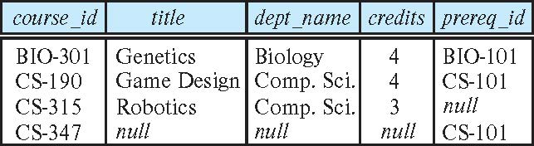
Full Outer Join
course natural full outer join prereq
In relational algebra: course ⟗ prereq

Slide 83
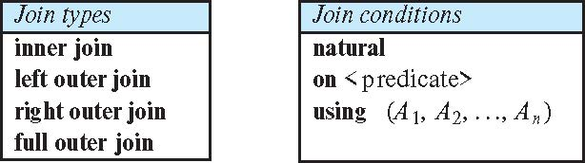
Joined Types and Conditions
Join operations take two relations and return as a result another relation.
These additional operations are typically used as subquery expressions in the from clause
Join condition – defines which tuples in the two relations match.
Join type – defines how tuples in each relation that do not match any tuple in the other relation (based on the join condition) are treated.

Slide 84
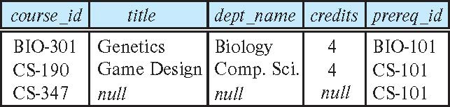
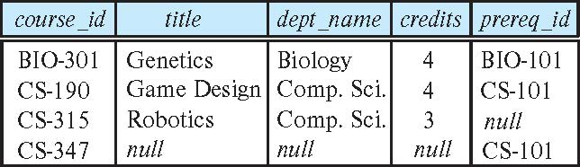
Joined Relations – Examples
course natural right outer join prereq
course full outer join prereq using (course_id)

Slide 85
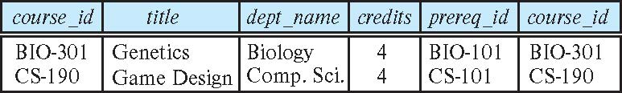
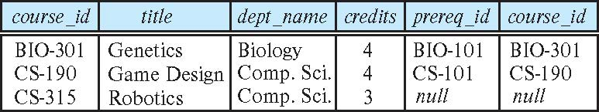
Joined Relations – Examples
course inner join prereq on course.course_id = prereq.course_id
What is the difference between the above, and a natural join?
course left outer join prereq on course.course_id = prereq.course_id

Slide 86
Joined Relations – Examples
course natural right outer join prereq
course full outer join prereq using (course_id)

Slide 87
Advanced Aggregation Features

Slide 88
Ranking
Ranking can be done using basic SQL aggregation, but resultant query is very inefficient
select ID, (1 + (select count(*) from student_grades B where B.GPA > A.GPA)) as s_rank from student_grades A order by s_rank;

Slide 89
Ranking
Ranking is done in conjunction with an order by specification.
Suppose we are given a relation student_grades(ID, GPA) giving the grade-point average of each student
Find the rank of each student.
select ID, rank() over (order by GPA desc) as s_rank from student_grades
An extra order by clause is needed to get them in sorted order
select ID, rank() over (order by GPA desc) as s_rank from student_grades order by s_rank
Ranking may leave gaps: e.g. if 2 students have the same top GPA, both have rank 1, and the next rank is 3
dense_rank does not leave gaps, so next dense rank would be 2
Notes:
89

Slide 90
Ranking (Cont.)
Ranking can be done within partition of the data.
“Find the rank of students within each department.”
select ID, dept_name, rank () over (partition by dept_name order by GPA desc) as dept_rank from dept_grades order by dept_name, dept_rank;
Multiple rank clauses can occur in a single select clause.
Ranking is done after applying group by clause/aggregation
Can be used to find top-n results
More general than the limit n clause supported by many databases, since it allows top-n within each partition

Slide 91
Ranking (Cont.)
For a given constant n, the ranking the function ntile(n) takes the tuples in each partition in the specified order, and divides them into n buckets with equal numbers of tuples.
E.g.,
select ID, ntile(4) over (order by GPA desc) as quartile
from student_grades;
Notes:
91

Slide 92
Windowing
A window function or analytic function
uses values from one or multiple rows to return a value for each row.
Window functions have an OVER clause
any function without an OVER clause is not a window function, but rather an aggregate or single-row (scalar) function.
Dep |empno| salary | avg
----------+-----+--------+--
develop |11 | 5200 | 5020
develop | 7 | 4200 | 5020
develop | 9 | 4500 | 5020
develop | 8 | 6000 | 5020
develop |10 | 5200 | 5020
personnel | 5 | 3500 | 3700
personnel | 2 | 3900 | 3700
sales | 3 | 4800 | 4866
sales | 1 | 5000 | 4866
sales | 4 | 4800 | 4866
SELECT dep, empno, salary, avg(salary)
OVER (PARTITION BY dep)
FROM empsalary;
Notes:
92

Slide 93
Windowing
SELECT
LAG(name, 1)
OVER(ORDER BY name) "prev",
name,
LEAD(name, 1)
OVER(ORDER BY name) "next"
FROM people
ORDER BY name
NAME |
--------------------
Aaron | ←Preceding (unbounded)
Andrew |
Amelia |
James |
Jill |
Johnny | ← 1st preceding row
Michael | ← Current row
Nick | ← 1st following row
Ophelia |
Zach | ← Following (unbounded)
| PREV | NAME | NEXT |
|--------|--- ----|----------|
| (null) | Aaron | Andrew |
| Aaron | Andrew | Amelia |
| Andrew | Amelia | James |
| Amelia | James | Jill |
| James | Jill | Johnny |
| Jill | Johnny | Michael |
| Johnny | Michael| Nick |
| Michael| Nick | Ophelia |
| Nick | Ophelia| Zach |
| Ophelia| Zach | (null) |
Notes:
93

Slide 94
Windowing (Cont.)
Can do windowing within partitions
E.g., Given a relation transaction (account_number, date_time, value), where value is positive for a deposit and negative for a withdrawal
“Find total balance of each account after each transaction on the account”
select account_number, date_time, sum (value) over (partition by account_number order by date_time rows unbounded preceding) as balance from transaction order by account_number, date_time
Notes:
94

Slide 95
Windowing
Used to smooth out random variations.
E.g., moving average: “Given sales values for each date, calculate for each date the average of the sales on that day, the previous day, and the next day”
Window specification in SQL:
Given relation sales(date, value)
select date, sum(value) over (order by date rows between 1 preceding and 1 following) from sales
Notes:
95

Slide 96
Windowing
Examples of other window specifications:
rows between unbounded preceding and current
rows unbounded preceding
range between 10 preceding and current row
All rows with values between current row value –10 to current value
range interval 10 day preceding
Not including current row
Notes:
96

Slide 97
Integrity Constraints
Integrity constraints guard against accidental damage to the database, by ensuring that authorized changes to the database do not result in a loss of data consistency.
A checking account must have a balance greater than $10,000.00
A salary of a bank employee must be at least $4.00 an hour
A customer must have a (non-null) phone number

Slide 98
Constraints on a Single Relation
not null
primary key
unique
check (P), where P is a predicate

Slide 99
Not Null Constraints
not null
Declare name and budget to be not null
name varchar(20) not null budget numeric(12,2) not null

Slide 100
Unique Constraints
unique ( A₁, A₂, …, A_{m})
The unique specification states that the attributes A₁, A₂, …, A_{m} form a candidate key.
Candidate keys are permitted to be null (in contrast to primary keys).

Slide 101
The check clause
The check (P) clause specifies a predicate P that must be satisfied by every tuple in a relation.
Example: ensure that semester is one of fall, winter, spring or summer
create table section
(course_id varchar (8),
sec_id varchar (8),
semester varchar (6),
year numeric (4,0),
building varchar (15),
room_number varchar (7),
time slot id varchar (4),
primary key (course_id, sec_id, semester, year),
check (semester in ('Fall', 'Winter', 'Spring', 'Summer')))

Slide 102
Referential Integrity
Ensures that a value that appears in one relation for a given set of attributes also appears for a certain set of attributes in another relation.
Example: If “Biology” is a department name appearing in one of the tuples in the instructor relation, then there exists a tuple in the department relation for “Biology”.
Let A be a set of attributes. Let R and S be two relations that contain attributes A and where A is the primary key of S. A is said to be a foreign key of R if for any values of A appearing in R these values also appear in S.

Slide 103
Referential Integrity (Cont.)
Foreign keys can be specified as part of the SQL create table statement
foreign key (dept_name) references department
By default, a foreign key references the primary-key attributes of the referenced table.
SQL allows a list of attributes of the referenced relation to be specified explicitly.
foreign key (dept_name) references department (dept_name)

Slide 104
Cascading Actions in Referential Integrity
When a referential-integrity constraint is violated, the normal procedure is to reject the action that caused the violation.
An alternative, in case of delete or update is to cascade
create table course ( (… dept_name varchar(20), foreign key (dept_name) references department on delete cascade on update cascade, . . .)
Instead of cascade we can use :
set null,
set default

Slide 105
Integrity Constraint Violation During Transactions
Consider:
create table person ( ID char(10), name char(40), mother char(10), father char(10), primary key ID, foreign key father references person, foreign key mother references person)
How to insert a tuple without causing constraint violation?
Insert father and mother of a person before inserting person
OR, set father and mother to null initially, update after inserting all persons (not possible if father and mother attributes declared to be not null)
OR defer constraint checking

Slide 106
Complex Check Conditions
The predicate in the check clause can be an arbitrary predicate that can include a subquery.
check (time_slot_id in (select time_slot_id from time_slot))
The check condition states that the time_slot_id in each tuple in the section relation is actually the identifier of a time slot in the time_slot relation.
The condition has to be checked not only when a tuple is inserted or modified in section , but also when the relation time_slot changes

Slide 107
Assertions
An assertion is a predicate expressing a condition that we wish the database always to satisfy.
The following constraints, can be expressed using assertions:
For each tuple in the student relation, the value of the attribute tot_cred must equal the sum of credits of courses that the student has completed successfully.
An instructor cannot teach in two different classrooms in a semester in the same time slot
An assertion in SQL takes the form:
create assertion <assertion-name> check (<predicate>);

Slide 108
Built-in Data Types in SQL
date: Dates, containing a (4 digit) year, month and date
Example: date '2005-7-27'
time: Time of day, in hours, minutes and seconds.
Example: time '09:00:30' time '09:00:30.75'
timestamp: date plus time of day
Example: timestamp '2005-7-27 09:00:30.75'
interval: period of time
Example: interval '1' day
Subtracting a date/time/timestamp value from another gives an interval value
Interval values can be added to date/time/timestamp values

Slide 109
Large-Object Types
Large objects (photos, videos, CAD files, etc.) are stored as a large object:
blob: binary large object -- object is a large collection of uninterpreted binary data (whose interpretation is left to an application outside of the database system)
clob: character large object -- object is a large collection of character data
When a query returns a large object, a pointer is returned rather than the large object itself.

Slide 110
User-Defined Types
create type construct in SQL creates user-defined type
create type Dollars as numeric (12,2) final
Example:
create table department (dept_name varchar (20), building varchar (15), budget Dollars);

Slide 111
Domains
create domain construct in SQL-92 creates user-defined domain types
create domain person_name char(20) not null
Types and domains are similar. Domains can have constraints, such as not null, specified on them.
Example:
create domain degree_level varchar(10) constraint degree_level_test check (value in ('Bachelors', 'Masters', 'Doctorate'));

Slide 112
Index Creation
Many queries reference only a small proportion of the records in a table.
It is inefficient for the system to read every record to find a record with particular value
An index on an attribute of a relation is a data structure that allows the database system to find those tuples in the relation that have a specified value for that attribute efficiently, without scanning through all the tuples of the relation.
We create an index with the create index command
create index <name> on <relation-name> (attribute);

Slide 113
Index Creation Example
create table student (ID varchar (5), name varchar (20) not null, dept_name varchar (20), tot_cred numeric (3,0) default 0, primary key (ID))
create index studentID_index on student(ID)
The query:
select * from student where ID = '12345'
can be executed by using the index to find the required record, without looking at all records of student

Slide 114
Authorization
We may assign a user several forms of authorizations on parts of the database.
Read - allows reading, but not modification of data.
Insert - allows insertion of new data, but not modification of existing data.
Update - allows modification, but not deletion of data.
Delete - allows deletion of data.
Each of these types of authorizations is called a privilege. We may authorize the user all, none, or a combination of these types of privileges on specified parts of a database, such as a relation or a view.

Slide 115
Authorization (Cont.)
Forms of authorization to modify the database schema
Index - allows creation and deletion of indices.
Resources - allows creation of new relations.
Alteration - allows addition or deletion of attributes in a relation.
Drop - allows deletion of relations.

Slide 116
Authorization Specification in SQL
The grant statement is used to confer authorization
grant <privilege list> on <relation or view > to <user list>
<user list> is:
a user-id
public, which allows all valid users the privilege granted
A role (more on this later)
Example:
grant select on department to Amit, Satoshi
Granting a privilege on a view does not imply granting any privileges on the underlying relations.
The grantor of the privilege must already hold the privilege on the specified item (or be the database administrator).

Slide 117
Privileges in SQL
select: allows read access to relation, or the ability to query using the view
Example: grant users U₁, U₂, and U₃ select authorization on the instructor relation:
grant select on instructor to U₁, U₂, U₃
insert: the ability to insert tuples
update: the ability to update using the SQL update statement
delete: the ability to delete tuples.
all privileges: used as a short form for all the allowable privileges

Slide 118
Revoking Authorization in SQL
The revoke statement is used to revoke authorization.
revoke <privilege list> on <relation or view> from <user list>
Example:
revoke select on student from U₁, U₂, U₃
<privilege-list> may be all to revoke all privileges the revokee may hold.
If <revokee-list> includes public, all users lose the privilege except those granted it explicitly.
If the same privilege was granted twice to the same user by different grantees, the user may retain the privilege after the revocation.
All privileges that depend on the privilege being revoked are also revoked.

Slide 119
Roles
A role is a way to distinguish among various users as far as what these users can access/update in the database.
To create a role we use:
create a role <name>
Example:
create role instructor
Once a role is created we can assign “users” to the role using:
grant <role> to <users>

Slide 120
Roles Example
create role instructor;
grant instructor to Amit;
Privileges can be granted to roles:
grant select on takes to instructor;
Roles can be granted to users, as well as to other roles
create role teaching_assistant
grant teaching_assistant to instructor;
Instructor inherits all privileges of teaching_assistant
Chain of roles
create role dean;
grant instructor to dean;
grant dean to Satoshi;

Slide 121
Authorization on Views
create view geo_instructor as (select * from instructor where dept_name = 'Geology');
grant select on geo_instructor to geo_staff
Suppose that a geo_staff member issues
select * from geo_instructor;
What if
geo_staff does not have permissions on instructor?
Creator of view did not have some permissions on instructor?

Slide 122
Other Authorization Features
references privilege to create foreign key
grant reference (dept_name) on department to Mariano;
Why is this required?
transfer of privileges
grant select on department to Amit with grant option;
revoke select on department from Amit, Satoshi cascade;
revoke select on department from Amit, Satoshi restrict;
And more!

